Slide 1
EEE 2015 ELECTRICS
L03 AC Circuit Analysis&Power Calculations

Slide 2
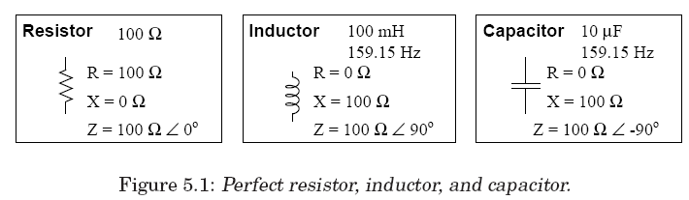
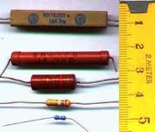
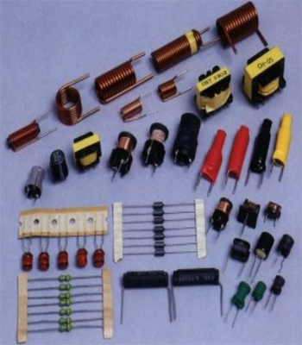
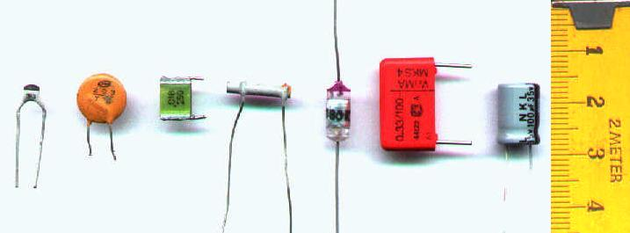
L02 Alternating Voltage and Current
Behaviors of Basic Circuit Components under AC
Coil (L)
(Inductor)
Capacitor(C)
(Condenser)
Resistor (R)
Dr. Levent ÇETİN

Slide 3
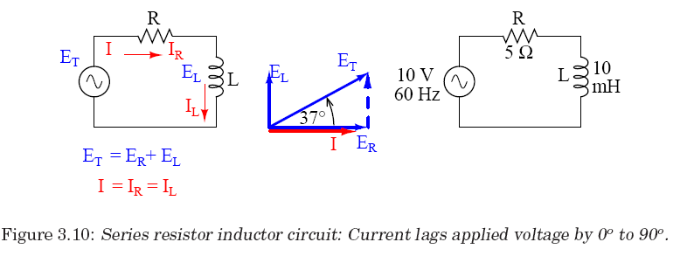
L02 Alternating Voltage and Current
AC circuit –RL in series
Inductive reactance of the coil
The total effect is called as impedance.
Dr. Levent ÇETİN

Slide 4
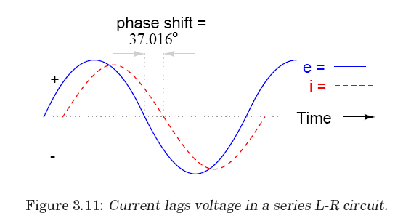
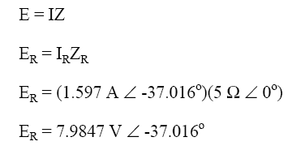
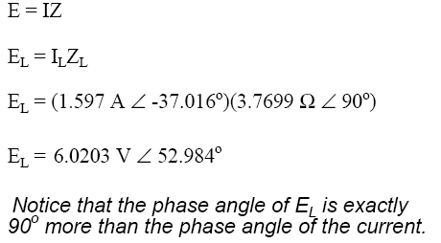
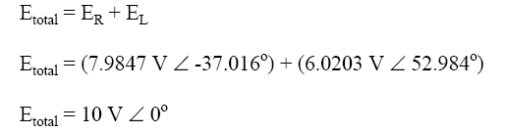
L02 Alternating Voltage and Current
AC circuit –RL in series
Dr. Levent ÇETİN

Slide 5
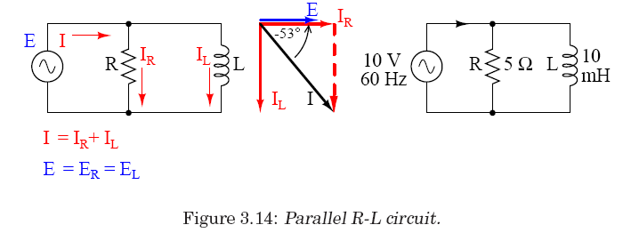
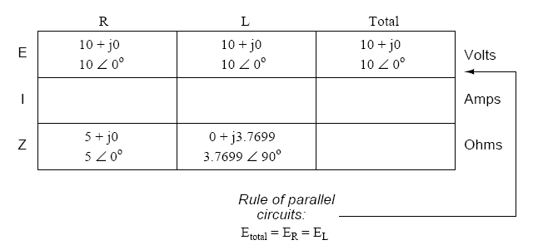
L02 Alternating Voltage and Current
AC circuit –RL in parallel
Dr. Levent ÇETİN

Slide 6
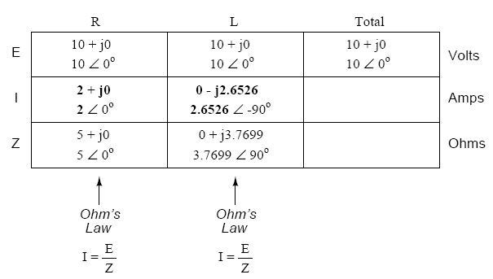
L02 Alternating Voltage and Current
AC circuit –RL in parallel
Dr. Levent ÇETİN

Slide 7
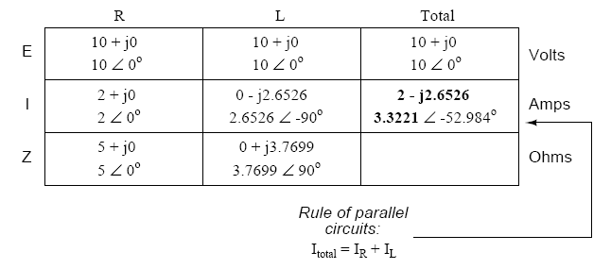
L02 Alternating Voltage and Current
AC circuit –RL in parallel
Dr. Levent ÇETİN

Slide 8
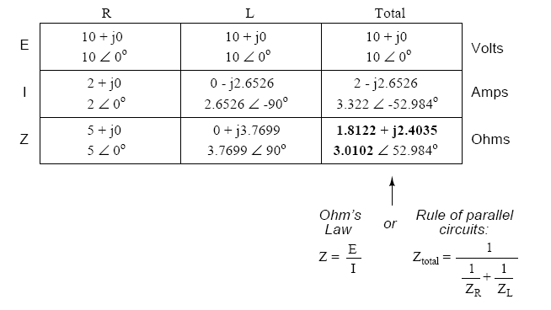
L02 Alternating Voltage and Current
AC circuit –RL in parallel
Dr. Levent ÇETİN

Slide 9
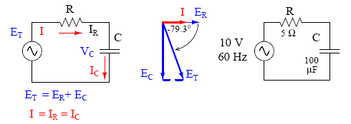
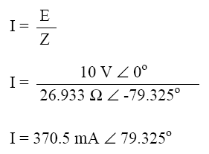
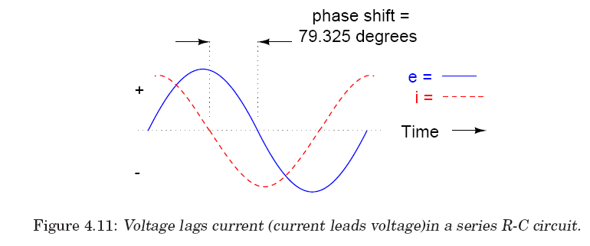
L02 Alternating Voltage and Current
AC circuit –RC in series
Dr. Levent ÇETİN

Slide 10
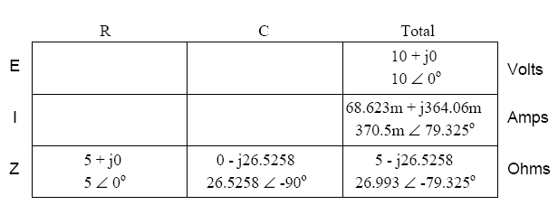
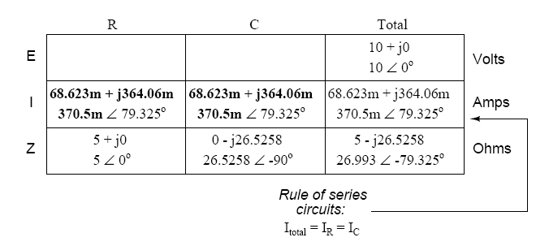
L02 Alternating Voltage and Current
AC circuit –RC in series
Dr. Levent ÇETİN

Slide 11
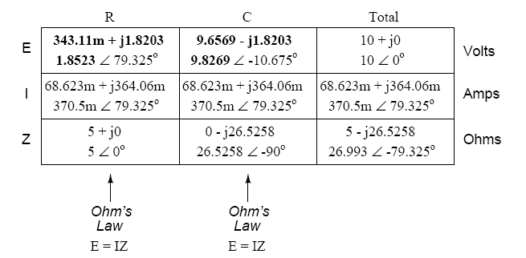
L02 Alternating Voltage and Current
AC circuit –RC in series
As it can be considered easily, the phase shift is 79.325 degrees in this circuit whereas in the circuit that has only one capacitor it was 90 degrees.
The current and the voltage on the resistor is on the same phase as it is mentioned. However, the current on a capacitor leads voltage by 90 degrees.
Dr. Levent ÇETİN

Slide 12
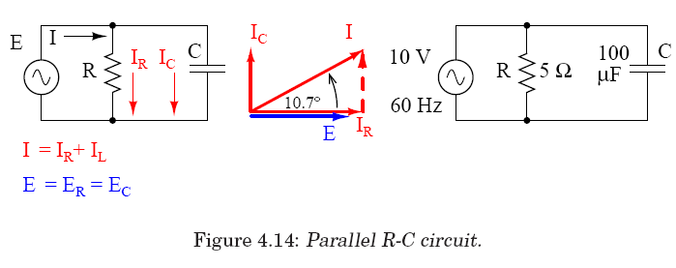
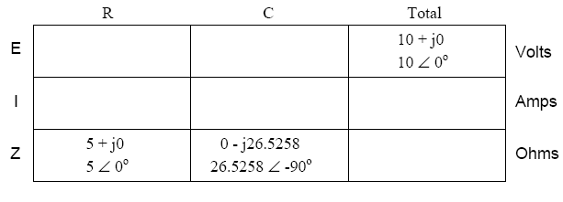
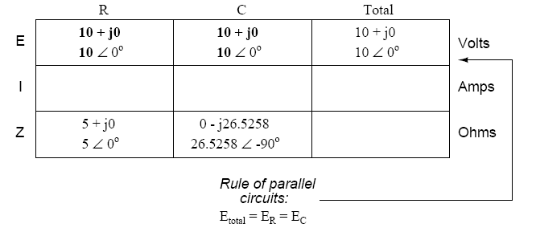
L02 Alternating Voltage and Current
AC circuit –RC in parallel
Dr. Levent ÇETİN

Slide 13
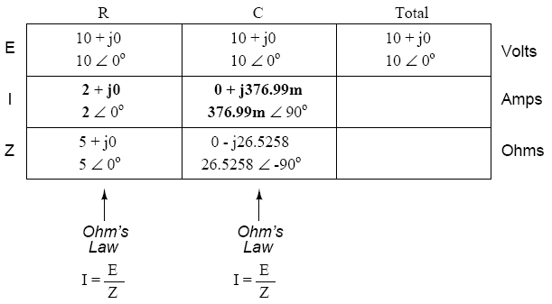
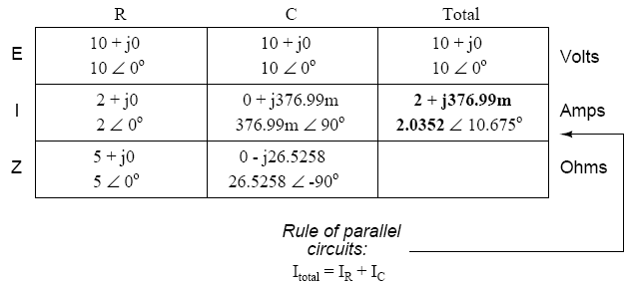
L02 Alternating Voltage and Current
AC circuit –RC in parallel
Dr. Levent ÇETİN

Slide 14
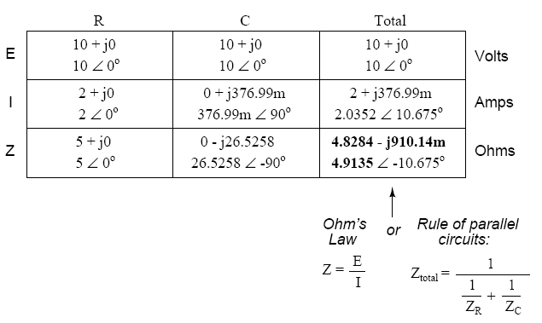
L02 Alternating Voltage and Current
AC circuit –RC in parallel
Dr. Levent ÇETİN

Slide 15
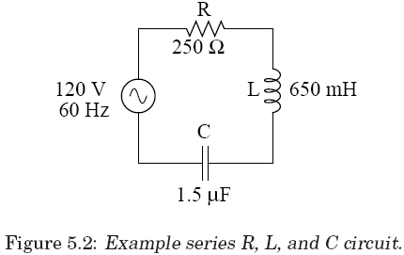
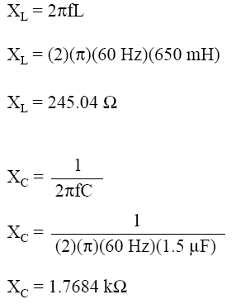
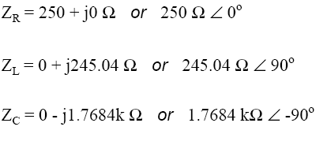
L02 Alternating Voltage and Current
AC circuit –RLC in series
Dr. Levent ÇETİN

Slide 16
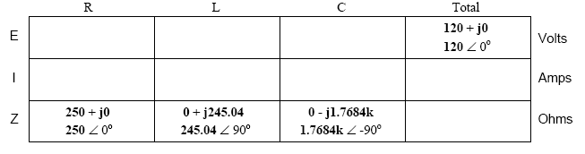
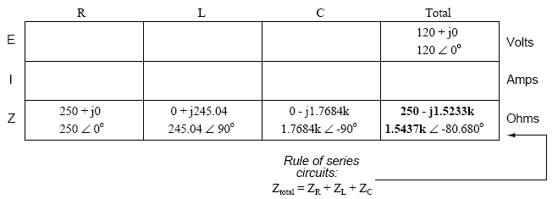
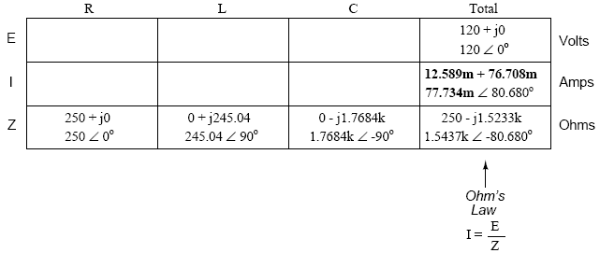
L02 Alternating Voltage and Current
AC circuit –RLC in series
Dr. Levent ÇETİN

Slide 17
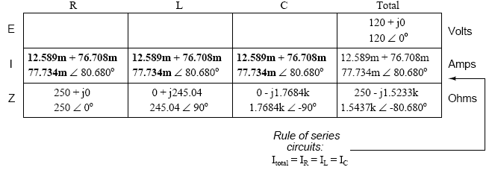
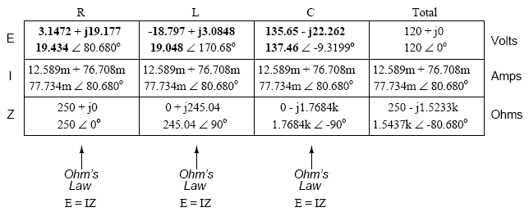
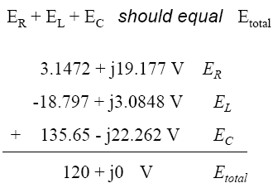
L02 Alternating Voltage and Current
AC circuit –RLC in series
It should be considered that the amplitude of the voltage on the capacitor is greater than the voltage supplied to the circuit. The influence of the impedance in the whole circuit is smaller than the influence of impedance of any single component. This case causes higher voltages on single components.
Dr. Levent ÇETİN

Slide 18
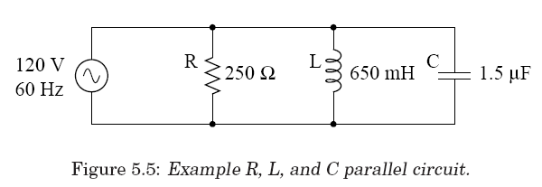
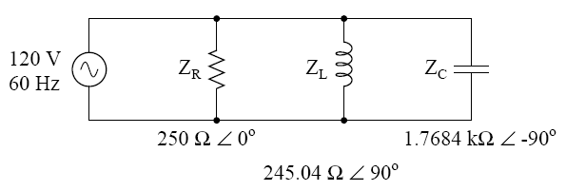
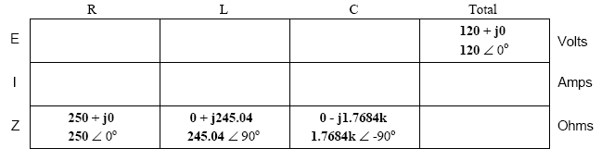
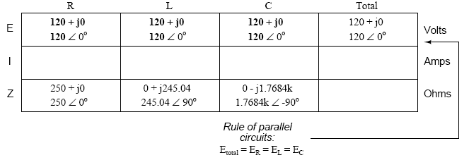
L02 Alternating Voltage and Current
AC circuit –RLC in paralel
Dr. Levent ÇETİN

Slide 19
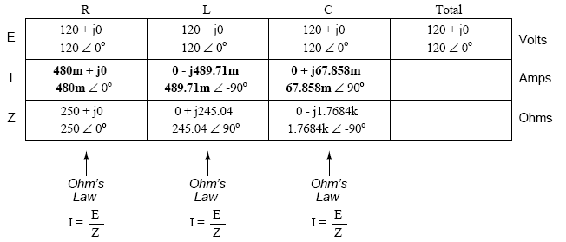
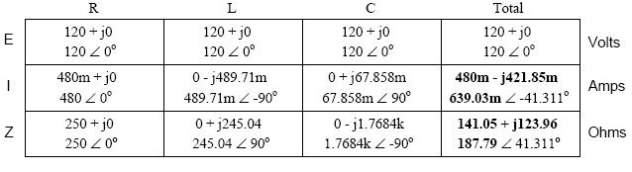
L02 Alternating Voltage and Current
AC circuit –RLC in paralel
Dr. Levent ÇETİN

Slide 20
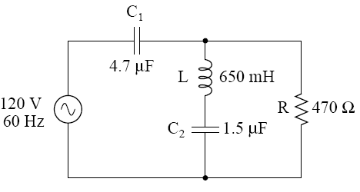
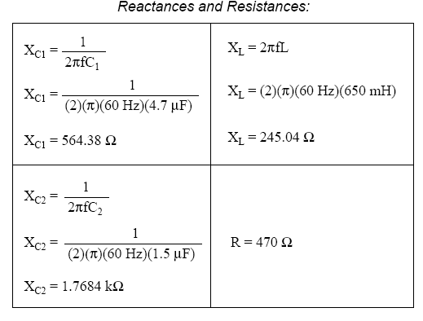
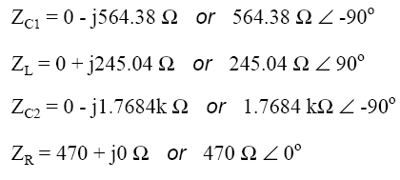
L02 Alternating Voltage and Current
AC circuit –Complex Circuit
Dr. Levent ÇETİN

Slide 21
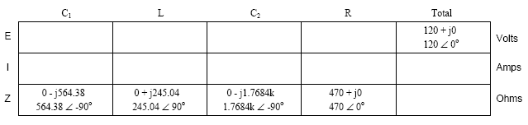
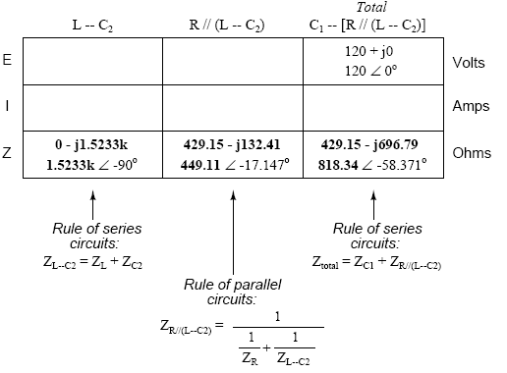
L02 Alternating Voltage and Current
AC circuit –Complex Circuit
The calculation of impedance in this circuit should be completed step by step.
First, serial connection branch of C₂ and L,
afterwards the parallel branch of resistor and last the serial capacitor effects should be calculated.
Dr. Levent ÇETİN

Slide 22
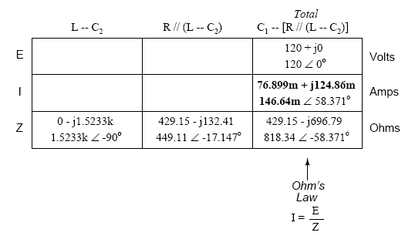
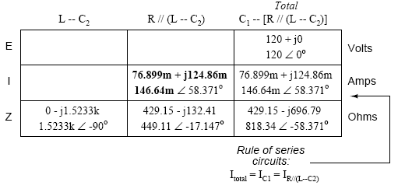
L02 Alternating Voltage and Current
AC circuit –Complex Circuit
Calculate current drawn from source and passing through C₁
Same current is passing through L-C₂ branch
Dr. Levent ÇETİN

Slide 23
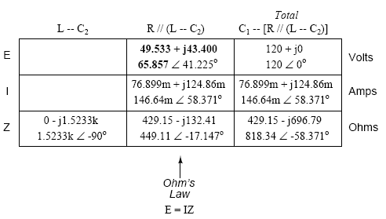
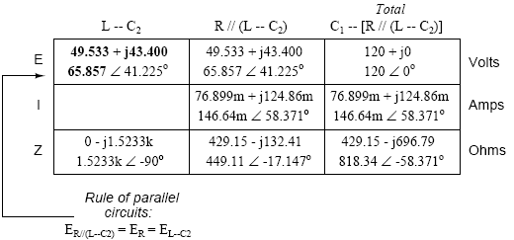
L02 Alternating Voltage and Current
AC circuit –Complex Circuit
Voltage drop on L-C₂ branch
Same Voltage drops on parallel R branch
Dr. Levent ÇETİN

Slide 24


L02 Alternating Voltage and Current
AC circuit –Complex Circuit
Dr. Levent ÇETİN

Slide 25



L02 Alternating Voltage and Current
Power in AC circuit
Since it was mentioned, there is a phase shift between current and voltage in AC circuits. The reason is the complex number impedance as it was stated.
So there are three definitions in AC circuits which are related with power.
These are:
True power (active power),
Reactive power,
Apparent power.
Impedance Calculations:
Inductive Circuit
Capacitive Circuit
Dr. Levent ÇETİN

Slide 26





L02 Alternating Voltage and Current
Power in AC circuit
Dr. Levent ÇETİN

Slide 27

L02 Alternating Voltage and Current
Power in AC circuit
The power quantities are scalar quantities.
if we consider the 90 degrees of direction angle between the resistor and the reactance and phase shift in the circuit.
This perpendicular triangle is called as ‘Power Triangle
A part of the power cannot be converted to electrical work in an AC circuit.
The generated effective power is just as the true power.
Power factor is the cosine of the angle between the true and apparent powers (cos φ).
This value is equal to 1 in only circuits those have just resistors. But if there is a reactance, then the value is between 0 and 1.
Dr. Levent ÇETİN

Slide 28


L02 Alternating Voltage and Current
Power in AC circuit
The power factor value shows that the 70.5 % of the power used from the grid is served for the purpose.
Dr. Levent ÇETİN

Slide 29
L02 Alternating Voltage and Current
Compensation in AC circuit
The power factor value shows that the 70.5 % of the power used from the grid is served for the purpose.
This situation is not wanted.
So, in circuit design stage, it must be noted that the power factor is approximately equal to 1.
For this reason, the capacitive and inductive reactance values should be approximately equal to each other.
If this is not possible, a capacitor or an inductor should be externally added to the circuit. This improvement is called as compensation.
Dr. Levent ÇETİN

Slide 30

L02 Alternating Voltage and Current
Compensation in AC circuit
The circuit is inductive so a parallel capacitor should be added so that the total reactance of the circuit becomes approximately zero
In parallel branches voltage is constant so the necessary reactance value can be calculated using voltage based power formula
Dr. Levent ÇETİN

Slide 31


L02 Alternating Voltage and Current
Compensation in AC circuit
The calculated reactance value is used to find capacitor value
Dr. Levent ÇETİN

Slide 32

L02 Alternating Voltage and Current
Compensation in AC circuit
The capacitor value found is not a standart value for capacitors, so the closest standart value shold be chosen (22 µF) and connected in parallel with the circuit.
Dr. Levent ÇETİN

Slide 33



L02 Alternating Voltage and Current
Compensation in AC circuit
this improvement made the power factor closer to 1. Besides, the current is decreased.
Dr. Levent ÇETİN

Slide 34
L02 Alternating Voltage and Current
Compensation in AC circuit
Dr. Levent ÇETİN

